Slide 1
TWO-WAY ANOVA & INTERACTIONS

Slide 2
Factorial ANOVAs
More than one independent variable
A two-way ANOVA is an analysis that allows you to evaluate the combined effect of two experimental variables.
The categorical explanatory variables in ANOVA are called factors.
Each factor is a “grouping” variable such as type of treatment, gender, brand, and so on.
  Two-way = 2 Independent variables
  Three-way = 3 Independent variables etc.

Slide 3
Factorial ANOVAs
More than one independent variable
The two-way ANOVA tests to see if the factors are important (significant) either separately (called main effects) or in combination (via an interaction).
A main effect describes the individual relationship between one of the categorical variables and the response/dependent variable.
An interaction effect describes the extent to which the relationship between one explanatory variable and the response variable depends on the other explanatory variable.

Slide 4
The design is based on the assumption that the observations in the cells are independent within and between cells - There are no repeated objects or subjects in any factor combination.
Sometimes a two-way ANOVA is referred to as a
p ×q factorial design, where there are p levels of one factor and q levels of the other.

Slide 5
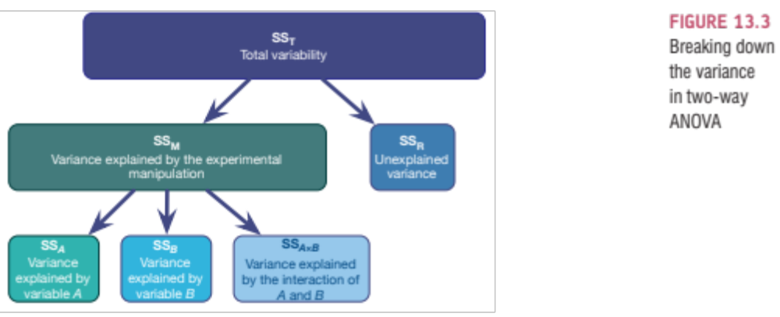
Breaking down the variance in a two-way ANOVA
Two-way ANOVA is basically the same as one-way ANOVA except that the model sum of squares is partitioned into three parts: the effect of each of the independent variables and the effect of how these variables interact.

Slide 6
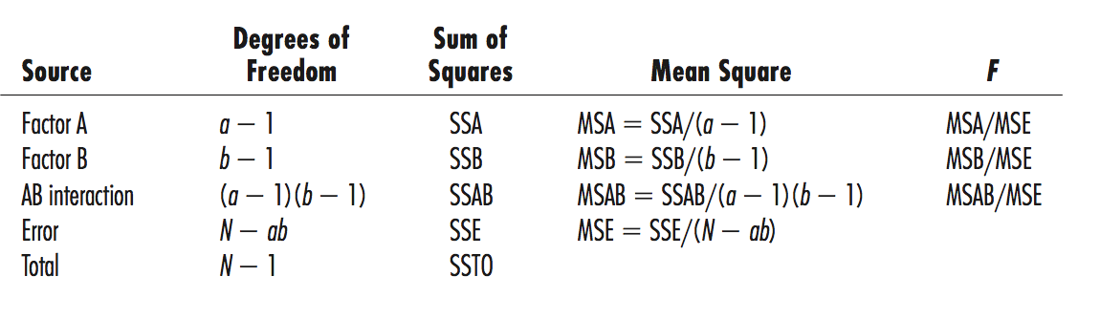
Two-way ANOVA Table

Slide 7
Factorial ANOVA - Key Assumptons
Independent samples. Subjects should be randomly assigned to treatment combinations, that is, to the p × q possible combinations of factors (cells). Observations are independent in that there are no repeated objects or subjects in any factor combination.
  The assumption of independence of the subjects is critically important.

Slide 8
Factorial ANOVA - Key Assumptons
Normality. Data within each cell of the design are assumed to be normally distributed. ANOVA models are robust against moderate departures from the assumption of normality
Equal variances. The population variances within each combination of factors should be equal.
The ANOVA is quite robust to the equal variance assumption if the cell sizes are equal or nearly equal. Homogeneity of variances is particularly important if sample sizes differ across levels of the independent variable(s).

Slide 9
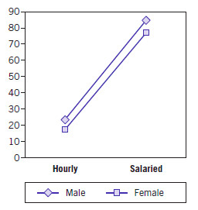
Interaction
Suppose the outcome variable is annual income (in thousands) and your two factors are gender and job.
The graph illustrates a situation in which the combined effects of the two factors are additive and there is no interaction effect. In this case, the salaried employees (both male and female) make about €55,000 to €60,000 per year more than the corresponding hourly employees of the same sex. Also, for each job category, the males make €5,000 to €10,000 more per year than the female employees on average. The result of this additive behavior is that the lines are almost parallel.

Slide 10
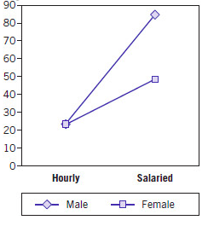
Interaction
This graph shows an interaction effect. For hourly employees, males and females have approximately the same average salaries. However, for salaried employees, males make about €35,000 more per year on average.
This behavior is an interaction -you cannot make a blanket statement comparing the effect of gender on salary that applies to both job types.
You will need to consider each job category separately. Similarly, the effect that employee type (hourly vs. salaried) has on salary is only really understood when it is considered separately for males and females.

Slide 11
Interaction
The main effects for each factor measure how much the means differ for the levels of that factor, averaged over all levels of the other factor.
The interaction effects measure how much the mean for each combination of the two explanatory variables differs from what it would be if the variables were considered separately.
If an interaction exists, the effects of the factors should not be interpreted in isolation from each other, and tests for main effects will often not be meaningful. - It will usually be more appropriate, for example, to compare effects of the first factor within levels of the second factor and vice versa.

Slide 12
Hypotheses in Two-Way ANOVA
Factor A
H₀: The population means are equal for all levels of Factor A.
Factor B
H₀: The population means are equal for all levels of Factor B.
Hypothesis for Interaction
H₀: The population means fit the additive model.

Slide 13
Two-way ANOVA
Example 1 (Display Strategies)
A manufacturer of a consumer retail product wants to examine the effectiveness of display strategies on sales.
Six different displays are designed, which include:
three different highlight colors (red, blue, and black) and two different heights: short (45 inches) and tall (60 inches).
To compare sales for each combination of height and color, one of the six display combinations is randomly placed at each of five discount department stores, a total of 30 different locations.
After 2 months, the sales from each combination are compared. We will assume the data in each cell are normally distributed.

Slide 14
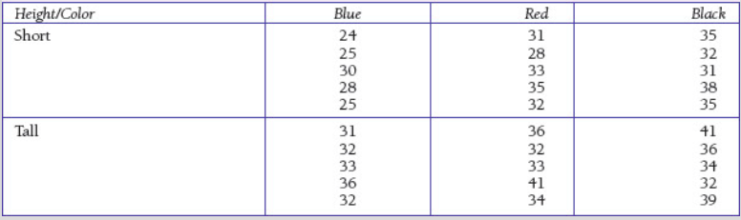
Two-way ANOVA
Example 1 (Display Strategies)
Example from IBM SPSS by Example. Elliot

Slide 15
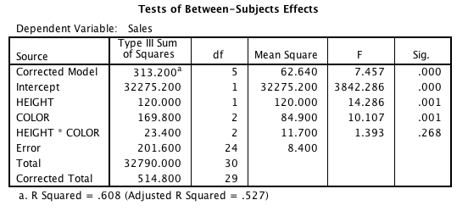
It is important to look at the interaction first because it may change the interpretation of the separate “main effects” of each independent variable. Look at the interaction term (Height * Colour).
The non-significant p = 0.268 indicates that the interaction term is not statistically significant. A graph (interaction plot) to visually examine the possibility of an interaction effect is shown on the next slide

Slide 16
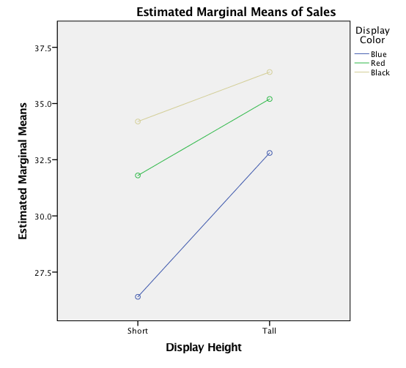
The lines showing the means for Sales by Height and colour are fairly close to parallel (as measured by the interaction p-value [p =0.268]), so the assumption of no interaction seems plausible.
Thus, it is appropriate to test for main effects, that is, to compare Sales by Colour and Sales by Height.

Slide 17
The main effect for height is significant (F =14.286 with 1 and 24 degrees of freedom, p =0.001). This indicates that there is a statistically significant difference in Sales by Height. Thus, taller displays produced significantly greater Sales. It should be noted that post hoc tests are not needed since there are only two levels of Height.
The main effect for Colour is also significant (F =10.107 with 2 and 24 degrees of freedom, p =0.001). This indicates that there is a statistically significant difference in Sales by Colour. However, post hoc tests are needed to determine which differences are significant.

Slide 18

The R Squared value is the percent of variance in sales predictable from both independent variables and the interaction.

Slide 19
Effect Size - Partial eta squared
Partial eta squared indicates the proportion of variance in the dependent variable that is due to the independent variable and not just random differences.
(Variance due to the independent variable, divided by variance due to the independent variable plus error variance.)

Slide 20
Two-way ANOVA
Example 1 - Reporting Results
A two-way ANOVA was performed to determine if there is a difference in average sales for displays with different heights or highlight colours. In the presence of a significant difference, multiple comparisons were performed using the Tukey procedure at the α=0.05 significance level.
The test for interaction was not significant, F(2, 24) =1.393, p =0.268. Since there was no significant interaction, we tested main effects. The main effect for height was significant, F(1, 24) =14.286, p=0.001, where it is seen that taller displays have higher average sales. The main effect for colour was also significant, F(2, 24) =10.107, p =0.001. Multiple comparisons using Tukey’s test indicate that black and red displays have higher average sales than blue displays.

Slide 21
Example 2
Two-way between-groups ANOVA
(Two Independent Variables – One dependent variable)
Refer again to ‘Total Optimism” example
New research question: What is the impact of age and gender on optimism?
Is there a interaction between age and gender so that the difference in optimism scores for males and for females changes on the basis age category?
We now have:
  Two categorical independent variables (Sex & Age Group)
  One continuous dependent variable (total optimism)
The usual assumptions for an ANOVA apply
SPSS command:
Analyse↵
General linear model↵
  

Slide 22
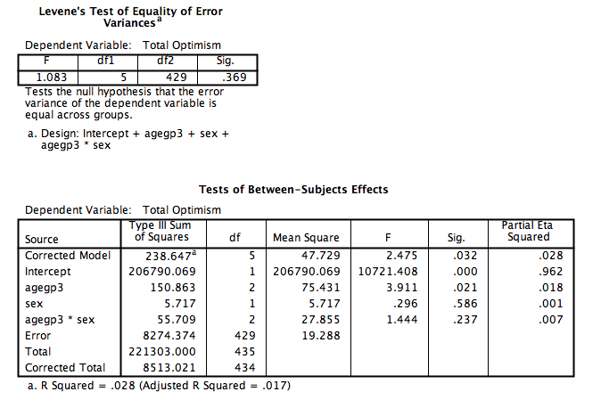

Slide 23
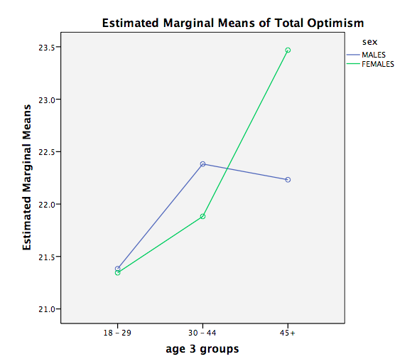

Slide 24
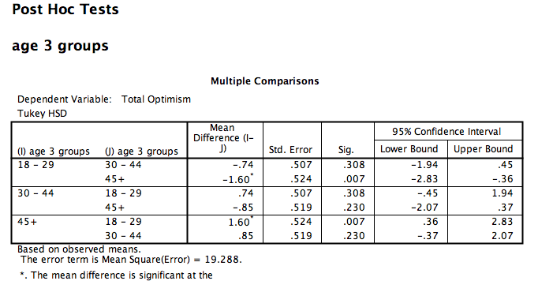

Slide 25
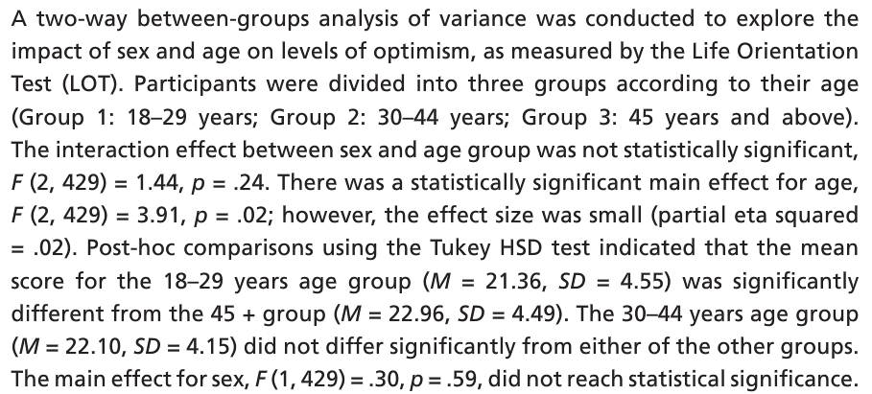
Presenting Results
Two-way between-groups ANOVA

Slide 26
What if we had found a significant interaction effect?
Follow up tests to explore the relationship further
Look at the results for each of the sub-groups separately
  e.g. split by sex and look at the effects of age on optimism separately for males and females.
Split the sample into groups (use SPSS split file command) and run separate one-way ANOVAs
SPSS
DATA – SPLIT FILE
ORGANISE OUTPUT BY GROUPS
Move variable into box marked Groups base on

Slide 27
TWO-WAY ANOVA & INTERACTIONS

Slide 28
Example 3 [Field 2013]
Testing the effects of Alcohol and Gender on ‘the beer-goggles effect’:
  IV 1 (Alcohol): None, 2 pints, 4 pints
  IV 2 (Gender): Male, Female
Dependent Variable (DV) was an objective measure of the attractiveness of the partner selected at the end of the evening.
Slide <number>

Slide 29
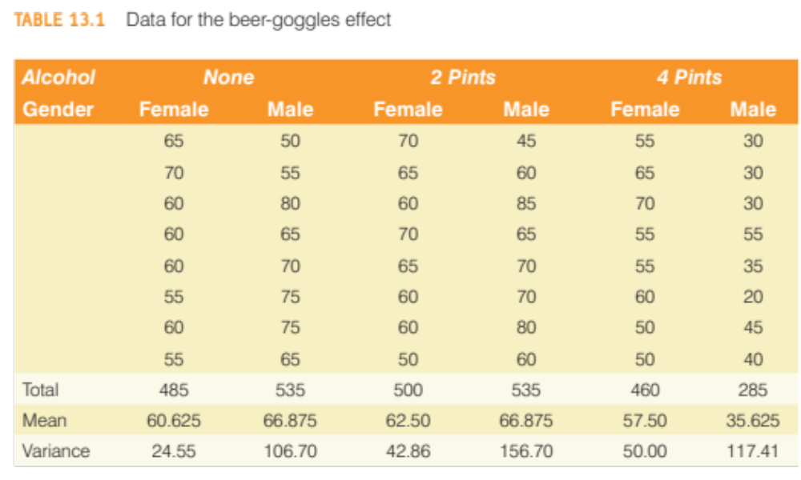
Slide <number>

Slide 30
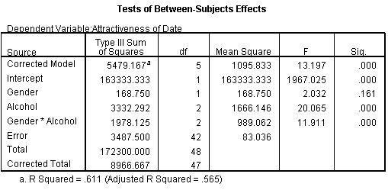


Summary Table
There was a significant main effect of the amount of alcohol consumed at the night-club, on the attractiveness of the mate that was selected, F(2, 42) = 20.07, p < .001.
There was a non-significant main effect of gender on the attractiveness of selected mates, F(1, 42) = 2.03, p = .161.
There was a significant interaction between the amount of alcohol consumed and the gender of the person selecting a mate, on the attractiveness of the partner selected, F(2, 42) = 11.91, p < .001.
Slide <number>

Slide 31
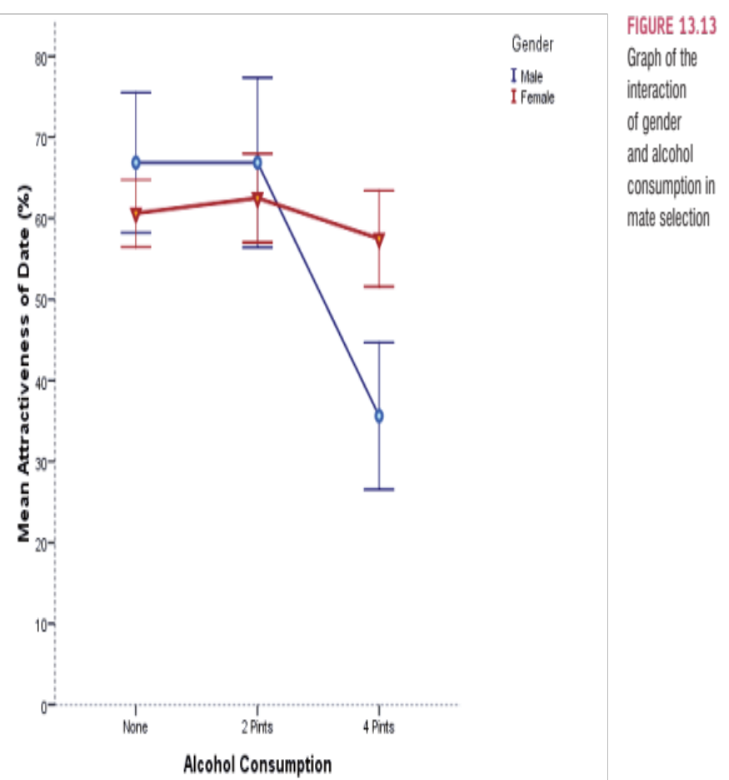

Interpretation: Interaction
The interaction shows non-parallel lines. That is for low does of alcohol male and female scores do not change much. At a high dose (4 pints) male scores plummet but female scores remain fairly high. So, the interaction is caused by a difference between males and females in the effect of alcohol.
Slide <number>

Slide 32
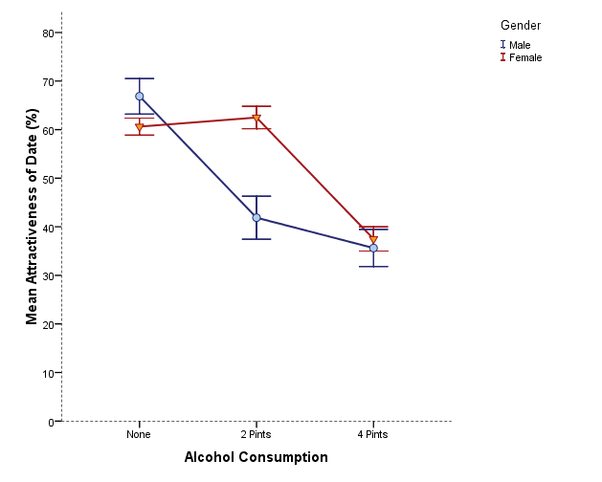
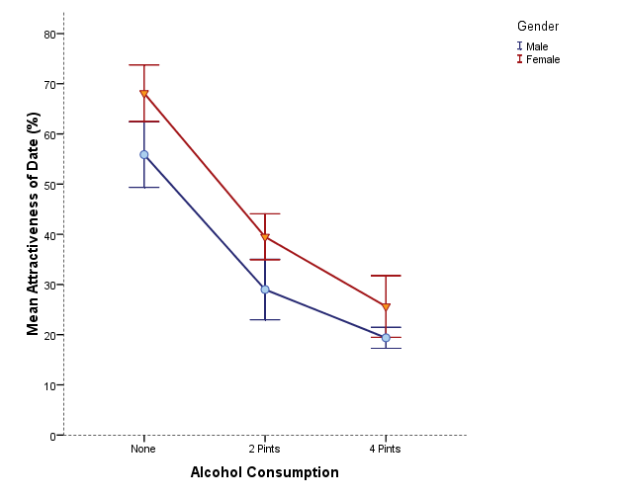


Is there likely to be a significant interaction effect?
Slide <number>

